Slide 1
Arithmetic for Computers

Slide 2
What we have learned …
Integer number representation
Decimal
Binary Representation
Hexadecimal

Slide 3
Arithmetic for Computers
§3.1 Introduction
Operations on integers
Addition and subtraction
Multiplication and division
Dealing with overflow
Floating-point real numbers
Representation and operations

Slide 4
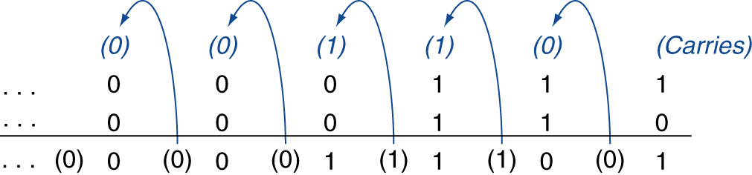
Integer Addition
Example: 7 + 6
§3.2 Addition and Subtraction
Overflow if result out of range
Adding +ve and –ve operands, no overflow
Adding two +ve operands
Overflow if result sign is 1
Adding two –ve operands
Overflow if result sign is 0

Slide 5
Integer Subtraction
Add negation of second operand
Example: 7 – 6 = 7 + (–6)
+7: 0000 0000 … 0000 0111 –6: 1111 1111 … 1111 1010 +1: 0000 0000 … 0000 0001
Overflow if result out of range
Subtracting two +ve or two –ve operands, no overflow
Subtracting +ve from –ve operand
Overflow if result sign is 0
Subtracting –ve from +ve operand
Overflow if result sign is 1

Slide 6
Dealing with Overflow
Some languages (e.g., C) ignore overflow
Use MIPS addu, addui, subu instructions
Other languages (e.g., Ada, Fortran) require raising an exception
Use MIPS add, addi, sub instructions

Slide 7
Logic Design
Electronics in modern computers is digital, distinguishing only high and low voltage.
A signal that is true, or 1, is asserted, a signal that is false, or 0 is deasserted.
0 and 1 are called complement or inverse of one another
Logic blocks are two types
Combinational – block without memory
State – output depends on but input and memory

Slide 8
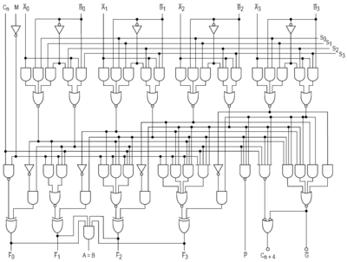
Example: Logic Block

Slide 9
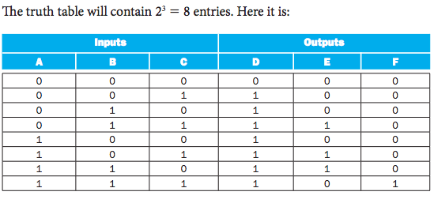
Specify Logic Blocks - 1

Slide 10
Specify Logic Blocks - 1
Boolean Algebra
The OR operator + , e.g, A + B (logical sum)
The AND operator . , e.g., A . B (logical product)
The unary operator NOT Ā

Slide 11
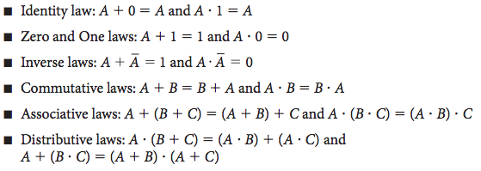
Laws of Boolean Algebra

Slide 12


Gates – imp. of basic logic functions
Logic blocks are build form gates
Gates – Are implementations of basic logic functions
AND gates – implementation of AND function
OR gates – implementation of OR functions
NOT gates – implementation of inverse
From left to right

Slide 13
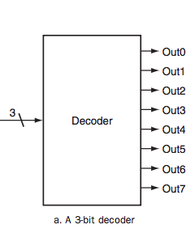
Other Basic Building Elements
Decoder

Slide 14
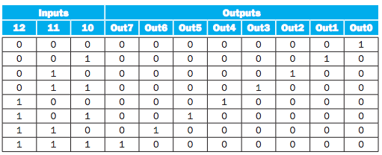
Decoder
Notes:
3 inputs 2^3 = 8 output

Slide 15
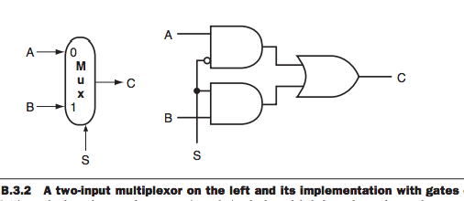
Other Basic Building Elements
Multiplexors
A multiplexor might properly be called as selector
Its output is one of the inputs that is selected by the control
Example: Two input multiplexor

Slide 16
Don’t Care
We do not care some input/output because another output is true or other subset of the input combinations determines the output

Slide 17
Construction of a Basic ALU
ALU – Arithmetic Logic Unit
It does
Generates random numbers
Addition, subtraction , logical operations AND, OR
Construction of ALU
AND gates, OR gates, Inverter, Multiplexer

Slide 18
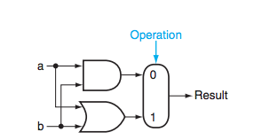
1-bit ALU
Logical unit for AND and OR

Slide 19
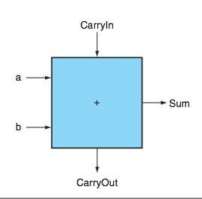
1-bit ALU
Addition
Two input for operands
One output for the sum
One output for CarryOut
Another input for CarryIn

Slide 20
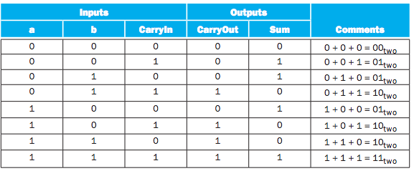
Truth Table Specification
1-bit adder

Slide 21

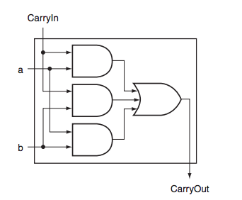
Logical Equation
CarryOut

Slide 22
Equation Sum

Slide 23
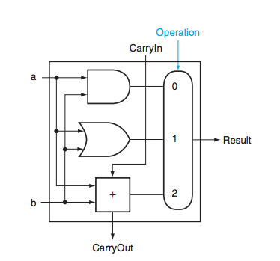
1-bit ALU (AND, OR, Adder)

Slide 24
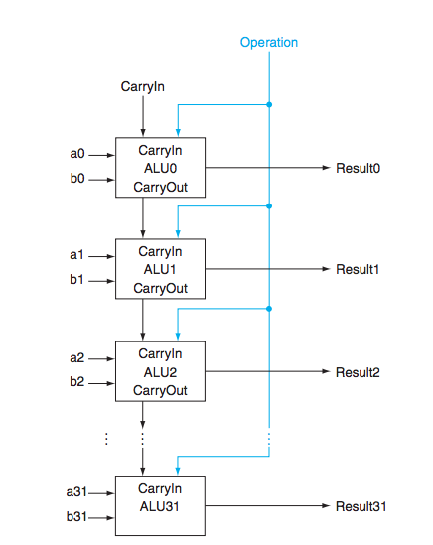
32-bit ALU (Adder)

Slide 25
Content Covered
Chapter 3
Section 3.1,3.2
Appendix B
B.1,B.2,B.3 (decoder, multiplexer)
B.5

